Slide 1
Python HW1 2024.03.20
大氣動力學 (I)

Slide 2
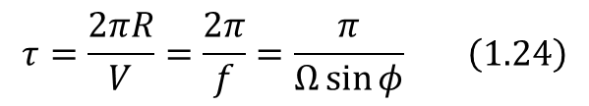
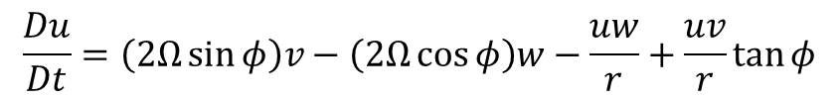
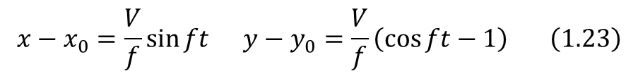
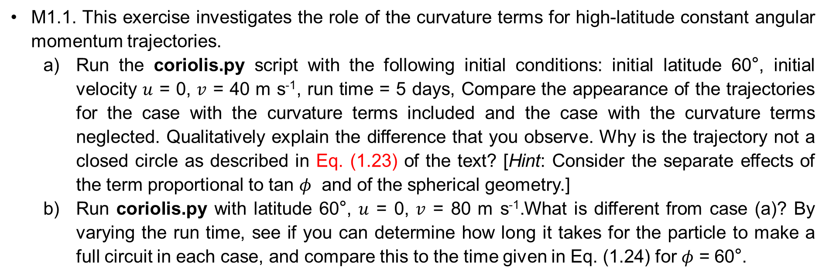
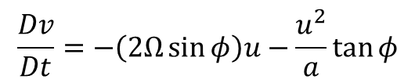
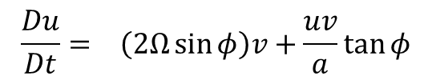
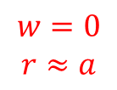
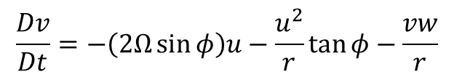
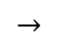
M1.1. This exercise investigates the role of the curvature terms for high-latitude constant angular momentum trajectories.
Run the coriolis.py script with the following initial conditions: initial latitude 60°, initial velocity $u$ = 0, $v$ = 40 m s⁻¹, run time = 5 days, Compare the appearance of the trajectories for the case with the curvature terms included and the case with the curvature terms neglected. Qualitatively explain the difference that you observe. Why is the trajectory not a closed circle as described in Eq. (1.23) of the text? [Hint: Consider the separate effects of the term proportional to tan $φ$ and of the spherical geometry.]
Run coriolis.py with latitude 60°, $u$ = 0, $v$ = 80 m s⁻¹.What is different from case (a)? By varying the run time, see if you can determine how long it takes for the particle to make a full circuit in each case, and compare this to the time given in Eq. (1.24) for $φ$ = 60°.
Coriolis force
Curvature
$$\frac{Du}{Dt}=\left(2Ω\sin{φ}\right)v−\left(2Ω\cos{φ}\right)w−\frac{uw}{r}+\frac{uv}{r}\tan{φ}$$
$$\frac{Du}{Dt}= \left(2Ω\sin{φ}\right)v+\frac{uv}{a}\tan{φ}$$
$$→$$
$$\frac{Dv}{Dt}=−\left(2Ω\sin{φ}\right)u−\frac{u^{2}}{r}\tan{φ}−\frac{vw}{r}$$
$$w=0$$
$$r≈a$$
$$\frac{Dv}{Dt}=−\left(2Ω\sin{φ}\right)u−\frac{u^{2}}{a}\tan{φ}$$
$$x−x_{0}=\frac{V}{f}\sin{ft} y−y_{0}=\frac{V}{f}\left(\cos{ft}−1\right) \left(1.23\right)$$
$$τ=\frac{2πR}{V}=\frac{2π}{f}=\frac{π}{Ω\sin{φ}} \left(1.24\right)$$

Slide 3
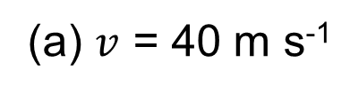
(a) $v$ = 40 m s⁻¹

Slide 4
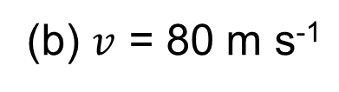
(b) $v$ = 80 m s⁻¹

Slide 5
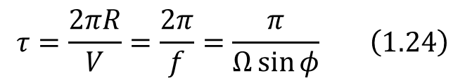
(b) One Full Circuit
$$τ=\frac{2πR}{V}=\frac{2π}{f}=\frac{π}{Ω\sin{φ}} \left(1.24\right)$$

Slide 6
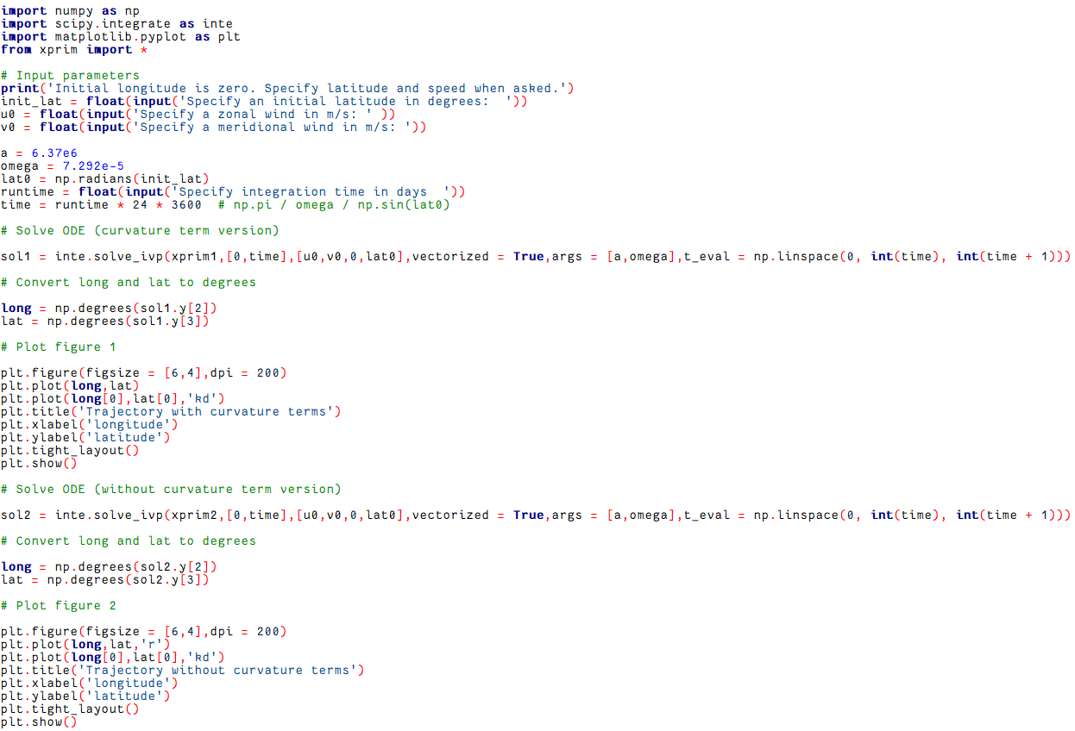
coriolis.py
Import data
Solve ODE
Rad. To degree
Plot

Slide 7
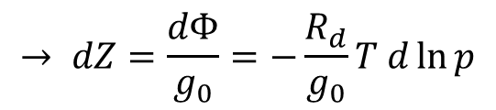
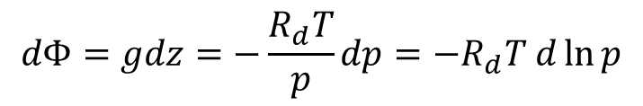
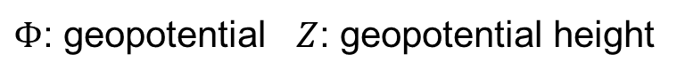
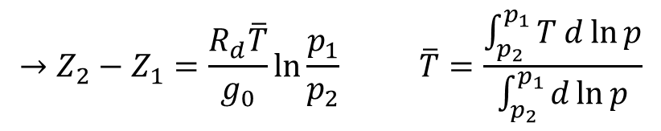
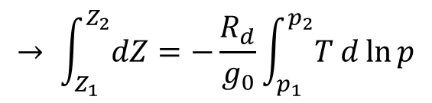
M2.2. The MATLAB script thermo_profile.m is a simple script to read in data giving pressure and temperature for a tropical mean sounding. Run this script to plot temperature versus pressure for data in the file tropical_temp.dat. Use the hypsometric equation to compute the geopotential height corresponding to each pressure level of the data file. Compute the corresponding potential temperature and plot graphs of the temperature and potential temperature variations with pressure and with geopotential height.
In a dry and hydrostatic atmosphere:
$Φ$: geopotential $Z$: geopotential height
$$dΦ=gdz=−\frac{R_{d}T}{p}dp=−R_{d}T d\ln{p}$$
$$→ \int_{Z_{1}}^{Z_{2}}{dZ}=−\frac{R_{d}}{g_{0}}\int_{p_{1}}^{p_{2}}{T d\ln{p}}$$
$$→ dZ=\frac{dΦ}{g_{0}}=−\frac{R_{d}}{g_{0}}T d\ln{p}$$
$$→Z_{2}−Z_{1}=\frac{R_{d}\overline{T}}{g_{0}}\ln{\frac{p_{1}}{p_{2}}} \overline{T}=\frac{\int_{p_{2}}^{p_{1}}{T d\ln{p}}}{\int_{p_{2}}^{p_{1}}{d\ln{p}}}$$

Slide 8
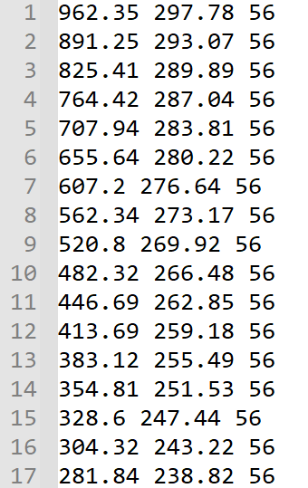
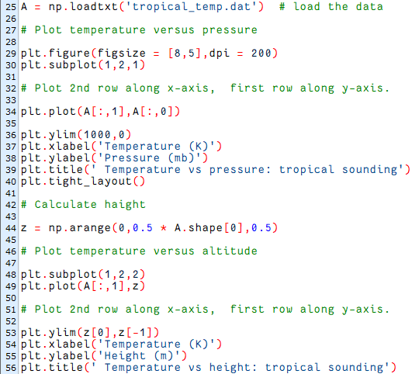
tropical_temp.dat
thermo_profile.py
Pressure
[mb]
Temperature
[K]
Number of
soundings
Load data
Plot temperature vs. pressure
The data is at altitude interval of 0.5 km starting at z = 0.5 km.
Plot temperature vs. height

Slide 9
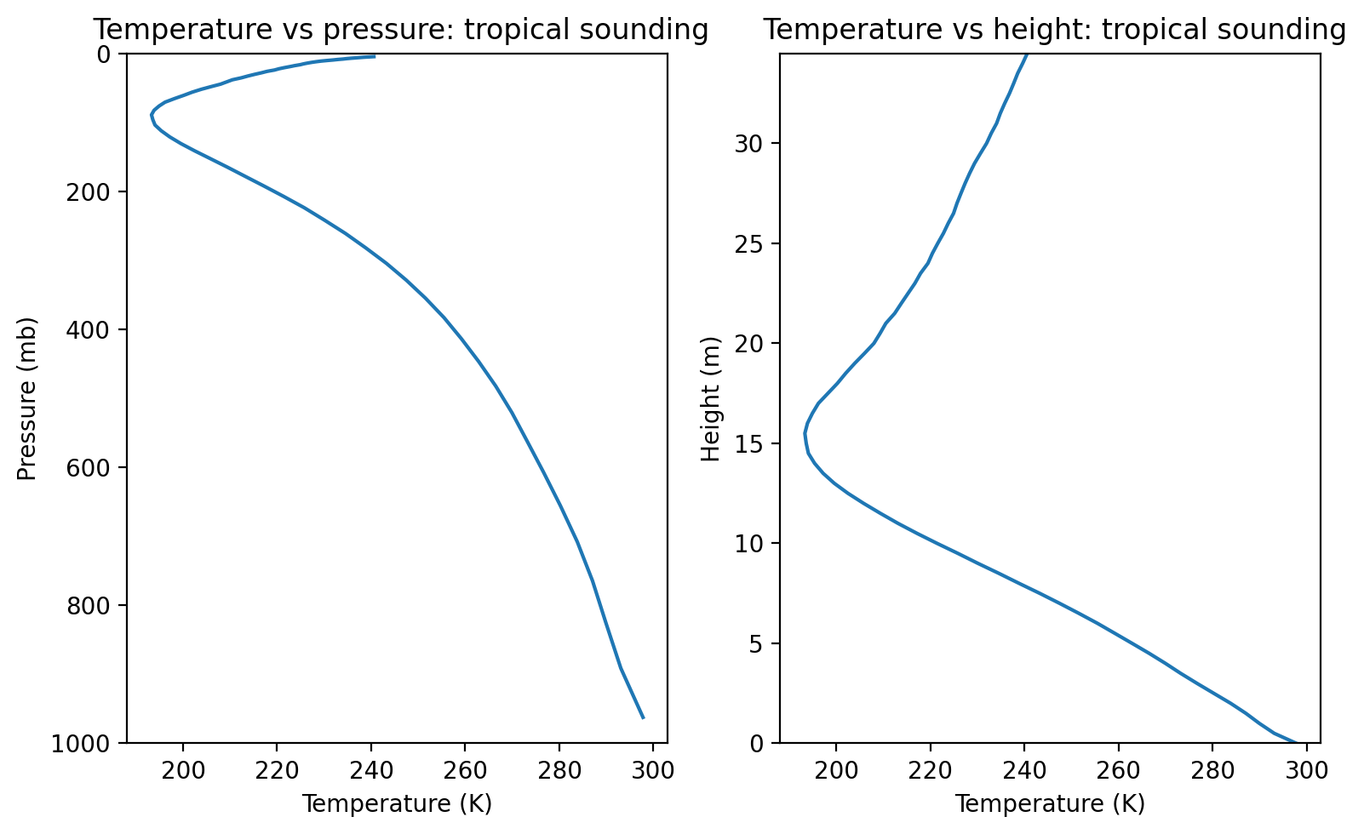
Temperature Profile in Pressure & Height Coordinate

Slide 10
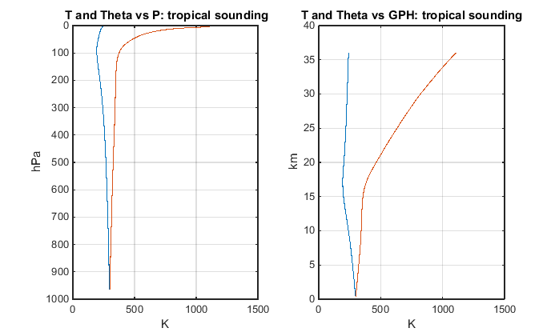
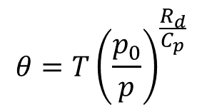
Potential Temperature Profile in Pressure & Geopotential Height Coordinate
$$θ=T{\left(\frac{p_{0}}{p}\right)}^{\frac{R_{d}}{C_{p}}}$$
Do it yourself!

Slide 11
注意事項:
Textbook HW1 deadline: 03/22 (Fri) 23:59
In-class problems 1 deadline: 03/22 (Fri) 23:59
Python HW1 (bonus) deadline: 03/29 (Fri.) 23:59
Mid-term exam 1 (Ch1 & Ch2) : 03/27 (Mon.) 08:10 – 10:00

Slide 12
注意事項:
繳交時請一律繳交.zip檔案
Zip檔案內需包含以下檔案:
學號_HW1
chapter_1
coriolis.py
xprim.py
學號_ch1.docx (M1.1)
chapter_2
thermo_profile.py (請將畫出溫度與位溫的程式碼一併寫於此檔案內)
tropical_temp.dat
學號_ch2.docx (M2.2)

